Slide 1
AIRBUS FARE PREDICTION WEB FRAMEWORK WITH THE USE OF MACHINE LEARNING MODEL
Submitted in the partial fulfillment for the award of the degree of
BACHELOR OF ENGINEERING
IN
CSE-IBM(BIG DATA & ANALYTICS)
Submitted by:
POLEMONI USHASWINI(18BCS3860)
Vemunuri Gnaneshwar Reddy(18BCS3818)
SURYA SNEHAVI SANAPALA(18BCS3854)
RAMSHAAHMED(18BCS3845)
Under the Supervision of:
JYOTI SHARMA
Department of AIT-CSE
DISCOVER . LEARN . EMPOWER

Slide 2
Outline
Introduction to Project
Problem Formulation
Objectives of the work
Methodology used
Results and Outputs
Conclusion
Future Scope
References

Slide 3
Introduction to Project
Passengers have little knowledge about future business price rates, so finding the best moment to buy an airline ticket is tough. Different methods predict future business plans prices and classify the ideal moment to buy a plane ticket.
Planes have a finite number of seats; airlines must manage demand. When demand is predicted to grow, the airline may raise prices to slow the rate at which seats are filled.
Reporting on the correlations and models that are used to price plane tickets. Then, based on that data, creating a model that assists travelers in selecting and purchasing tickets, as well as forecasting future air ticket costs.

Slide 4
Problem Formulation
In this project, we addressed the problem of market segment level airfare price prediction by using publicly available datasets and a novel machine learning framework to predict market segment level airfare price.
We created a website to predict the prices of airlines using the previous data and making an interface available for the users to use it.

Slide 5
Objectives
We are proposing a web page that by filling all the details it will give you the accuracy cost of flight based on the user filling the data. The input fields include the “departure date” that is , when you want to travel , upon next we have “arrival date” that is , when u want to reach the destination, upon next we have “source” and “destination” , later we have “stoppage” which means how many stops u needed to go from your source to the destination, later we have to choose an airline company to travel , it has in form of drop down and the input is called as “Which airline you want to travel?” Upon selecting and filling the all input ,click on the submit and we can see the predicted value on screen.

Slide 6
Methodology used
Data Collection:
Importing libraries
Exporting data
Preparing for model:
EDA
Handling categorical values
Test set
Feature selection
Fitting model using Random Forest & Saving in Pickle
Creating front end:
Html and CSS
Creating back end:
Flask

Slide 7
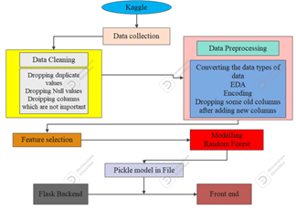
Methodology Architecture

Slide 8
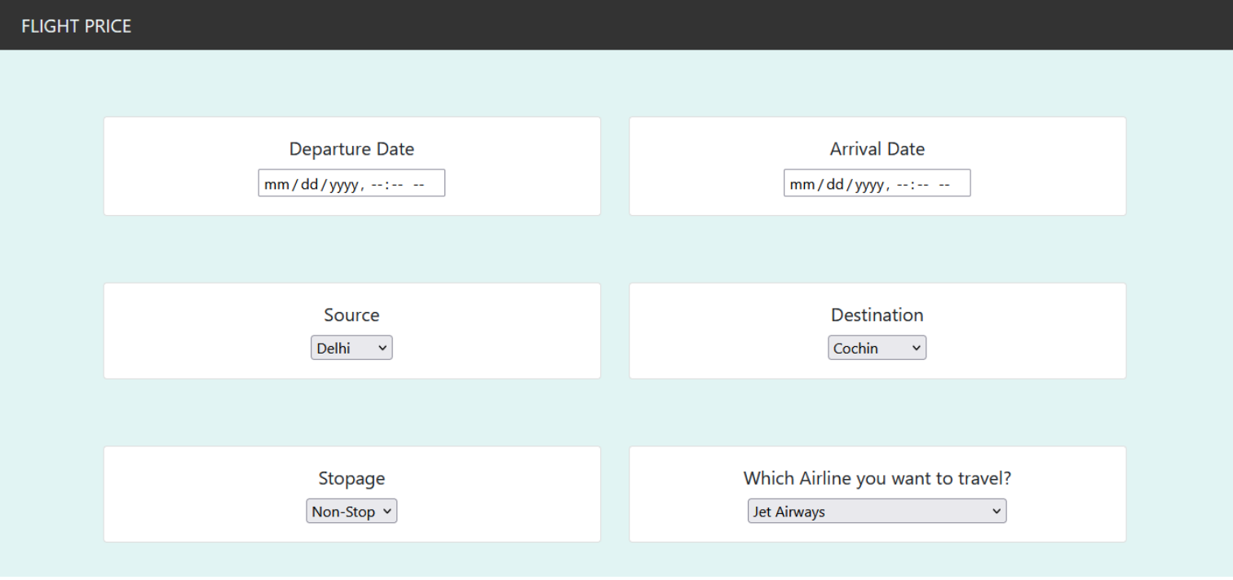
Results and Outputs
Form to fill details

Slide 9
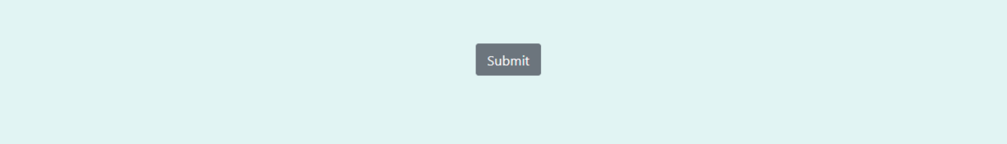
Results and Outputs
Submit button

Slide 10
Conclusion
By using this correctly we can save the money by giving the person information for related people to travel, so the person can decide to travel on a specific date or change the plans.
It has high scope in improving accuracy as data is growing day by day and we can use it as well as we can other types of Machine learning algorithms.

Slide 11
Future Scope
We can improve the front end and make it more user friendly.
We can get other features data like coupons ,days left until departure, overnight flight (yes or no),holiday day (yes or no) and we optimize the flask app.py, we may use django or any other web frameworks.
The analysis can be done by increasing the data points and increasing the historical data used.

Slide 12
References
[1] Pavithra Maria K and Anitha K L, 2021. “ like Duration, Source, Destination, Arrival, Departure.”. Available at:
<https://iarjset.com/wp-content/uploads/2021/04/IARJSET.2021.8321.pdf>
[2] Pavithra Maria K and Anitha K L, 2021. “airlines must manage demand. When demand is predicted to grow, the airline may raise prices in order to slow the rate at which seats.”. Available at:
<https://iarjset.com/wp-content/uploads/2021/04/IARJSET.2021.8321.pdf>
[3] Pavithra Maria K and Anitha K L, 2021. “ Price, Source, Destination and much more are the , used for flight price prediction..”. Available at: <https://iarjset.com/wp-content/uploads/2021/04/IARJSET.2021.8321.pdf>
[4] K. Tziridis, Th. Kalampokas, G. A. Papakostas, “Airfare Prices Prediction Using Machine Learning Techniques”, 25th European Signal Processing Conference (EUSIPCO), IEEE, October 26, 2017
[5] Tao Liu, Jian Cao, Yudong Tan, Quanwu Xiao, “ACER: An Adaptive Context- Aware Ensemble Regression Model for Airfare Price Prediction”, 2017 International Conference on Progress in Informatics and Computing (PIC), December 2017
[6] Supriya Rajankar, Neha Sakharkar, Omprakash Rajankar, “Predicting the price of a flight ticket with the use of Machine Learning algorithms”, international journal of scientific & technology research volume 8, December 2019
[7] www.Makemytrip.com
[8] Tianyi Wang, Samira Pouyanfar, Haiman Tian, Yudong Tao, Miguel Alonso Jr., Steven Luis and Shu-Ching Chen, “A Framework for Airfare Price Prediction: A Machine Learning Approach”, 2

Slide 13
References Cont.
[9]”Random forest is a kind of ensemble classifier Which is using a decision tree algorithm in a randomized fashion.”
Available at:https://www.educba.com/random-forest-vs-decision-tree/
[10] ”HTML stands for hypertext markup language, HTML is a language of the web”
Available at: https://support.picnet.net/hc/en-us
[11] Janhvi Mukane, Siddharth Pawar, Siddhi Pawar, Gaurav Muley “which required are Departure Time, Arrival Time, Source, Destination, Which flight and Number of stops”, International Journal for Research in Applied Science & Engineering Technology, Volume 10, Issue II, February 2022.
Available at: https://www.ijraset.com/research-paper/aircraft-ticket-price-prediction-using-machine-learning
[12]Vinod Kimbhaune, Harshil Donga, Asutosh Trivedi, Sonam Mahajan and Viraj Mahajan “The sklearn.metrics module will be used to implement the functions to measure the errors from each model using the regression metrics” May 19, 2021
Available at: https://easychair.org/publications/preprint_download/htzQ
[13]Tianyi Wang, SamairaPouyanfar, Haiman Tian, Yudong Tao. Available at:
https://www.researchgate.net/publication/335936877_A_Framework_for_Airfare_Price_Prediction_A_Machine_Learning_Approach
[14] Wang, T., Pouyanfar, S., Tian, H., Tao, Y., Alonso, M., Luis, S. and Chen, S.C., 2019, July. A framework for airfare price prediction: a machine learning approach. In 2019 IEEE 20th international conference on information reuse and integration for data science (IRI) (pp. 200-207). IEEE. Available at: https://www.researchgate.net/profile/Tianyi-Wang-30/publication/335936877_A_Framework_for_Airfare_Price_Prediction_A_Machine_Learning_Approach/links/5dc1efcb299bf1a47b18fdd7/A-Framework-for-Airfare-Price-Prediction-A-Machine-Learning-Approach.pdf

Slide 14
References Cont.
[15] Maheshwari, A., Davendralingam, N. and DeLaurentis, D.A., 2018. A comparative study of machine learning techniques for aviation applications. In 2018 Aviation Technology, Integration, and Operations Conference (p. 3980). Available at:
https://www.researchgate.net/profile/ApoorvMaheshwari/publication/325964700_A_Comparative_Study_of_Machine_Learning_Techniques_for_Aviation_Applications/links/5b3e97880f7e9b0df5f9d345/A-Comparative-Study-of-Machine-Learning-Techniques-for-Aviation-Applications.pdf
[16] Etzioni, O., Tuchinda, R., Knoblock, C.A. and Yates, A., 2003, August. To buy or not to buy: mining airfare data to minimize ticket purchase price. In Proceedings of the ninth ACM SIGKDD international conference on Knowledge discovery and data mining (pp. 119-128). Available at: https://dl.acm.org/doi/abs/10.1145/956750.956767
[17] Hengl, T., Mendes de Jesus, J., Heuvelink, G.B., Ruiperez Gonzalez, M., Kilibarda, M., Blagotić, A., Shangguan, W., Wright, M.N., Geng, X., Bauer-Marschallinger, B. and Guevara, M.A., 2017. SoilGrids250m: Global gridded soil information based on machine learning. PLoS one, 12(2), p.e0169748. Available at: https://journals.plos.org/plosone/article?id=10.1371/journal.pone.0169748
[18] Chou, J.S. and Ngo, N.T., 2016. Time series analytics using sliding window metaheuristic optimization-based machine learning system for identifying building energy consumption patterns. Applied energy, 177, pp.751-770. Available at;
https://www.sciencedirect.com/science/article/abs/pii/S0306261916306717
[19] Wang, Z., 2020. RWA: A Regression-based Scheme for Flight Price Prediction. Available at:
https://dalspace.library.dal.ca/handle/10222/79128
[20] Singh, J., Gupta, D. and Sharma, L., 2022. Analysis of Machine Learning Techniques for Airfare Prediction. In Computer Vision and Internet of Things (pp. 211-231). Chapman and Hall/CRC. Available at:
https://www.taylorfrancis.com/chapters/edit/10.1201/9781003244165-16/analysis-machine-learning-techniques-airfare-prediction-jaskirat-singh-deepa-gupta-lavanya-sharma

